Slide 1
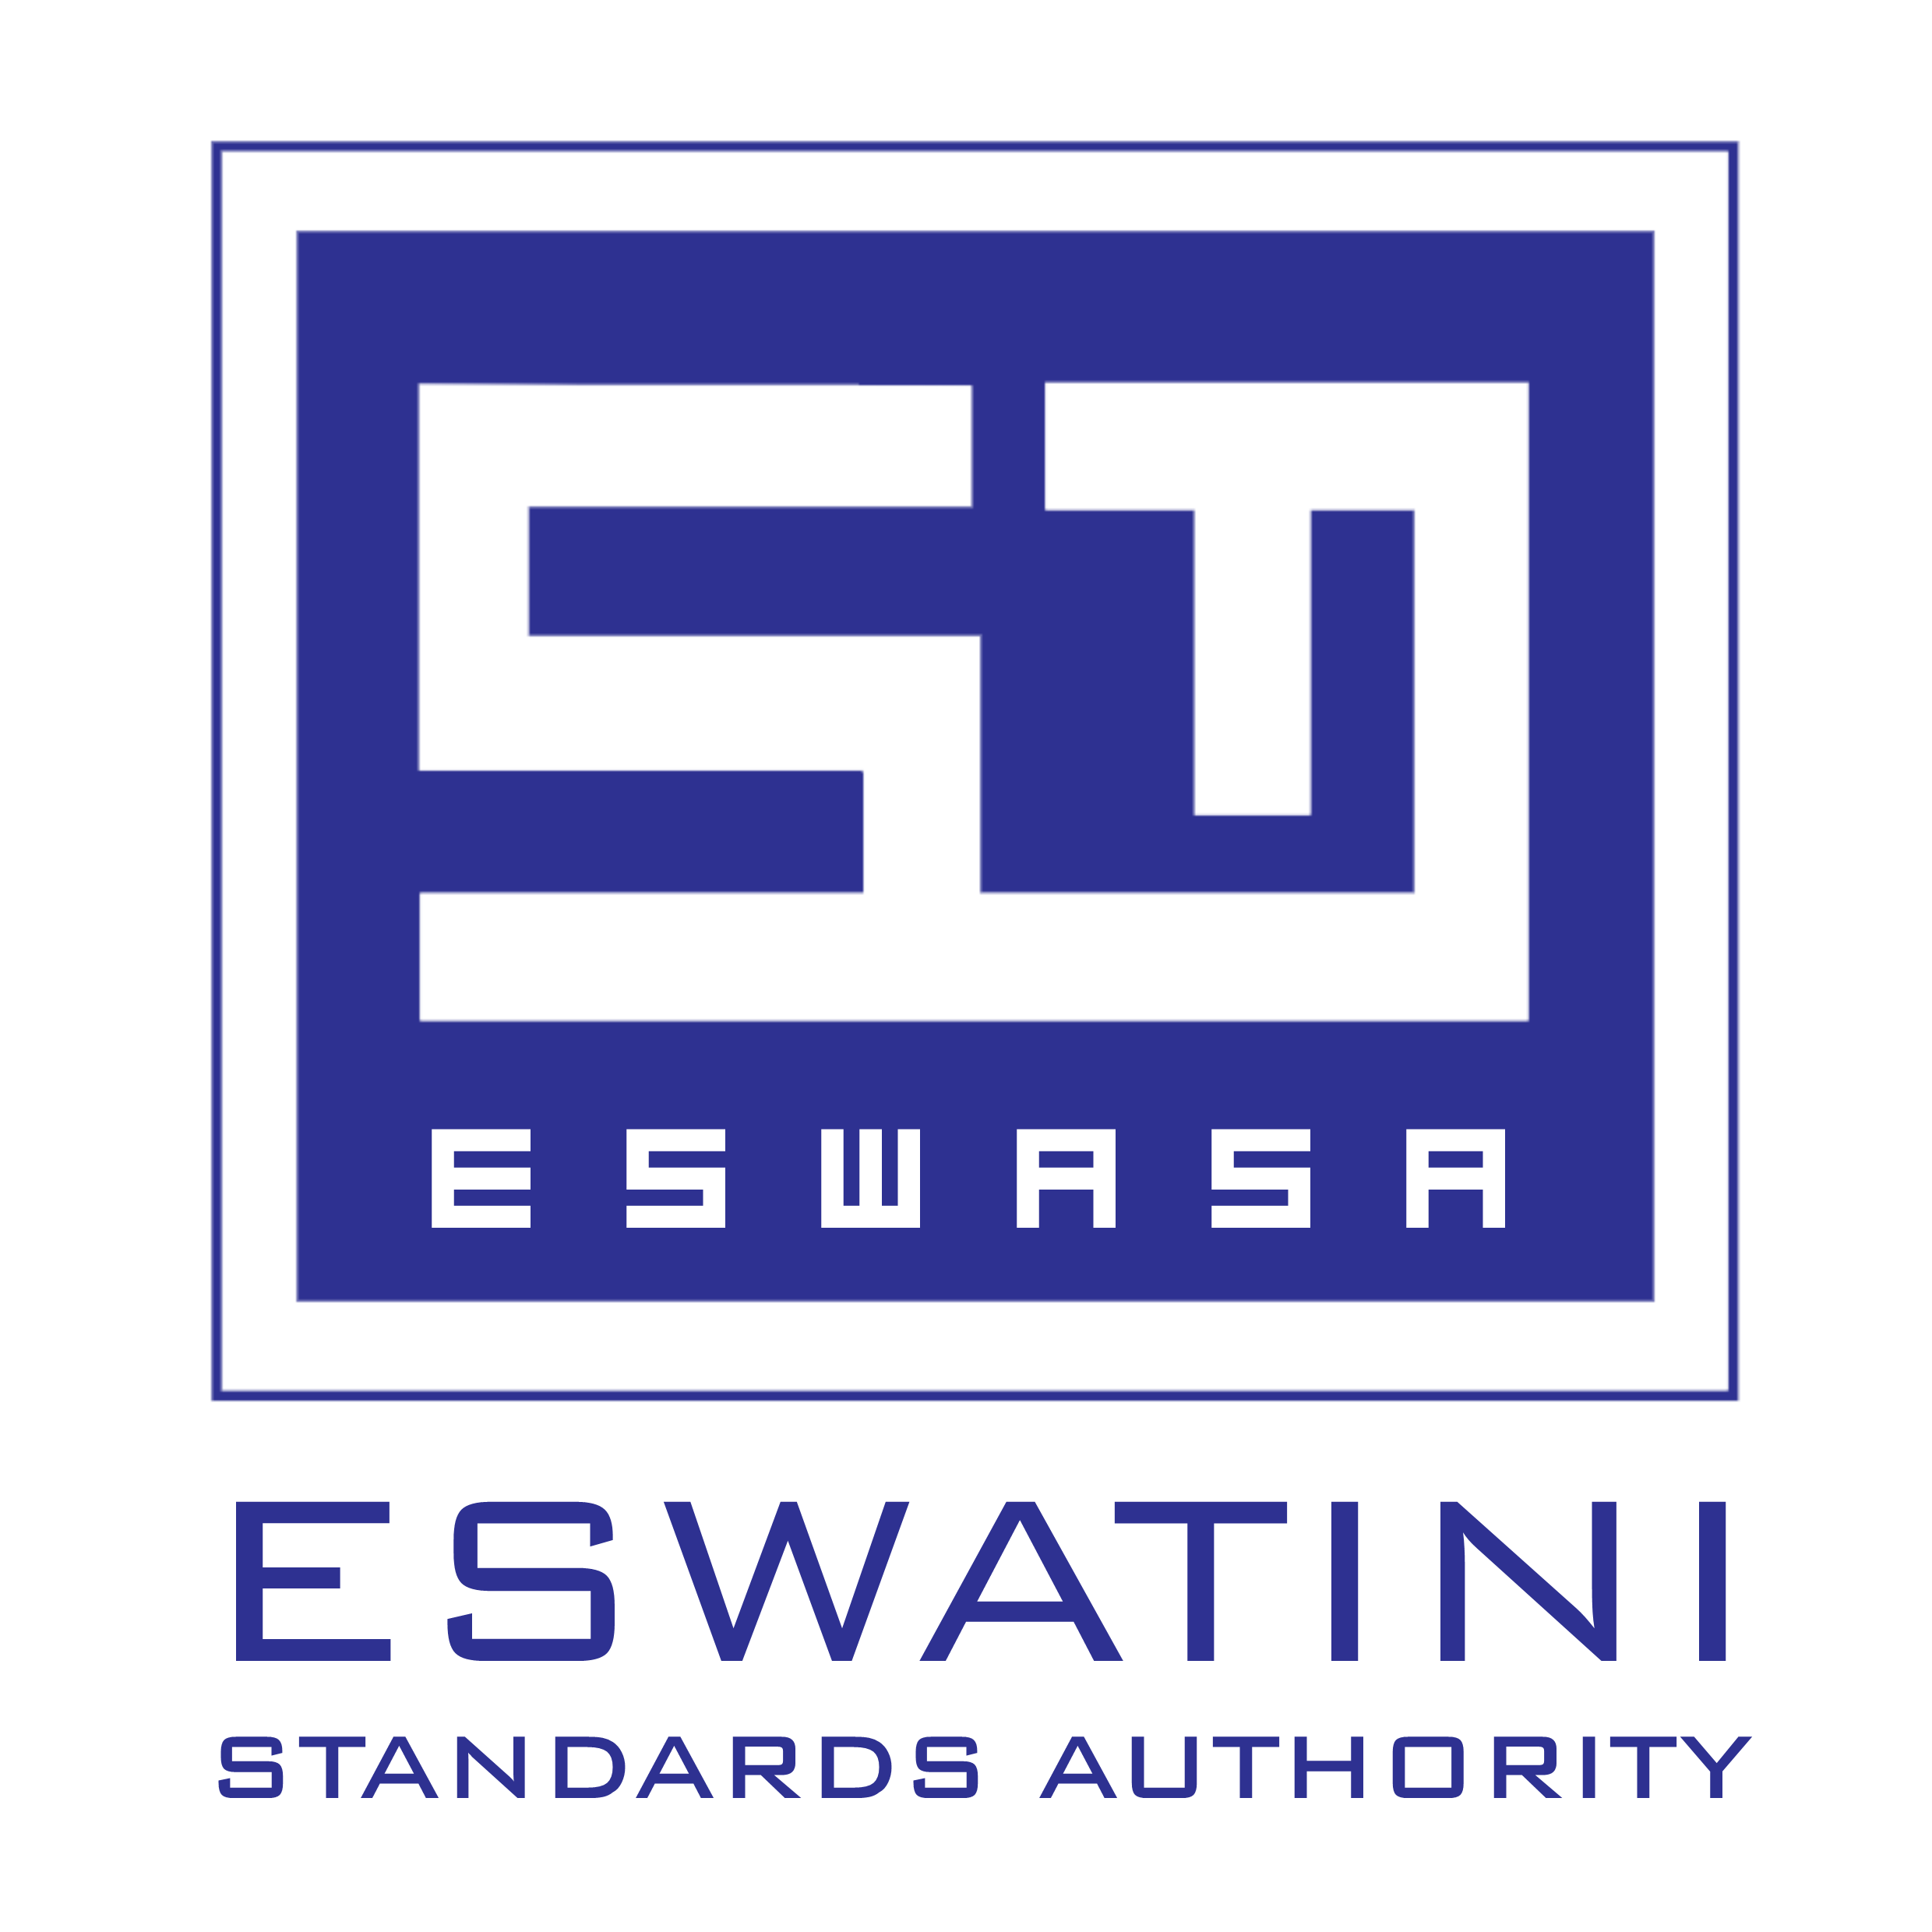

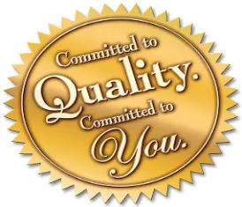


ESWASA CERTIFICATION
DUAL M INVESTMENTS
#ImprovingTheWorldWeLiveIn

Slide 2
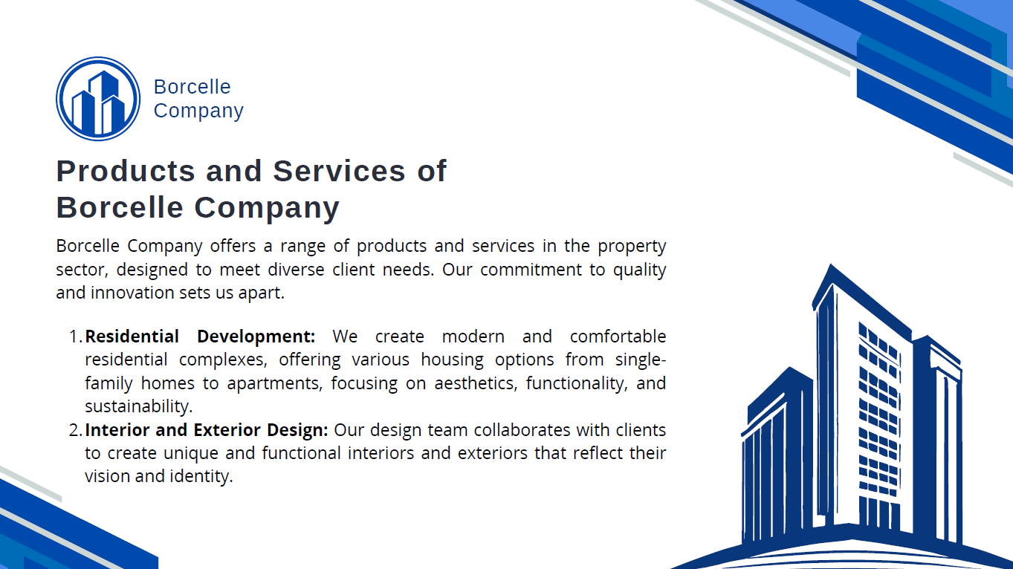
About Us
Vision
The outstanding service provider in quality standards for competitiveness.
Eswatini Standards Authority is the National Standards Body (NSB) of Eswatini
A Government Parastatal under the Ministry of Commerce, Industry and Trade (MCIT)
Established through the Standards & Quality Act (10) of 2003, reviewed in 2023
Started operations in 2007
Mission
We provide internationally recognized quality standards and conformity assessment services to improve business performance and promote trade.
#ImprovingTheWorldWeLiveIn

Slide 3
Our Core Values
Professionalism
We conduct our business affairs reliably, competently and we take accountability for our actions
Responsiveness
We do it right on time and react in a positive and desired manner to our market, customers and stakeholder expectations
People Centricity
We place people first, mutually beneficial relationships are of essence to our performance
Transparency
We are committed standardisers who conduct our business honestly and in openness
Innovation
We embrace and employ new ideas and improved ways in our business dealing
#ImprovingTheWorldWeLiveIn

Slide 4
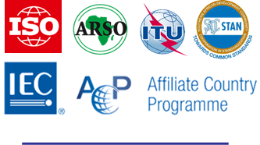

ESWASA Accreditation
ESWASA is a member of the following international organizations:
Eswatini Standards Authority – Management Systems Certification Services is accredited by the Southern African Development Community Accreditation Service (SADCAS).
Scopes: Quality Management Systems to ISO/IEC 17021-1:2015 and ISO/IEC 17021-3:2017 (Certification to ISO 9001:2015), IAF Codes 3, 12, 13 and 38
#ImprovingTheWorldWeLiveIn

Slide 5
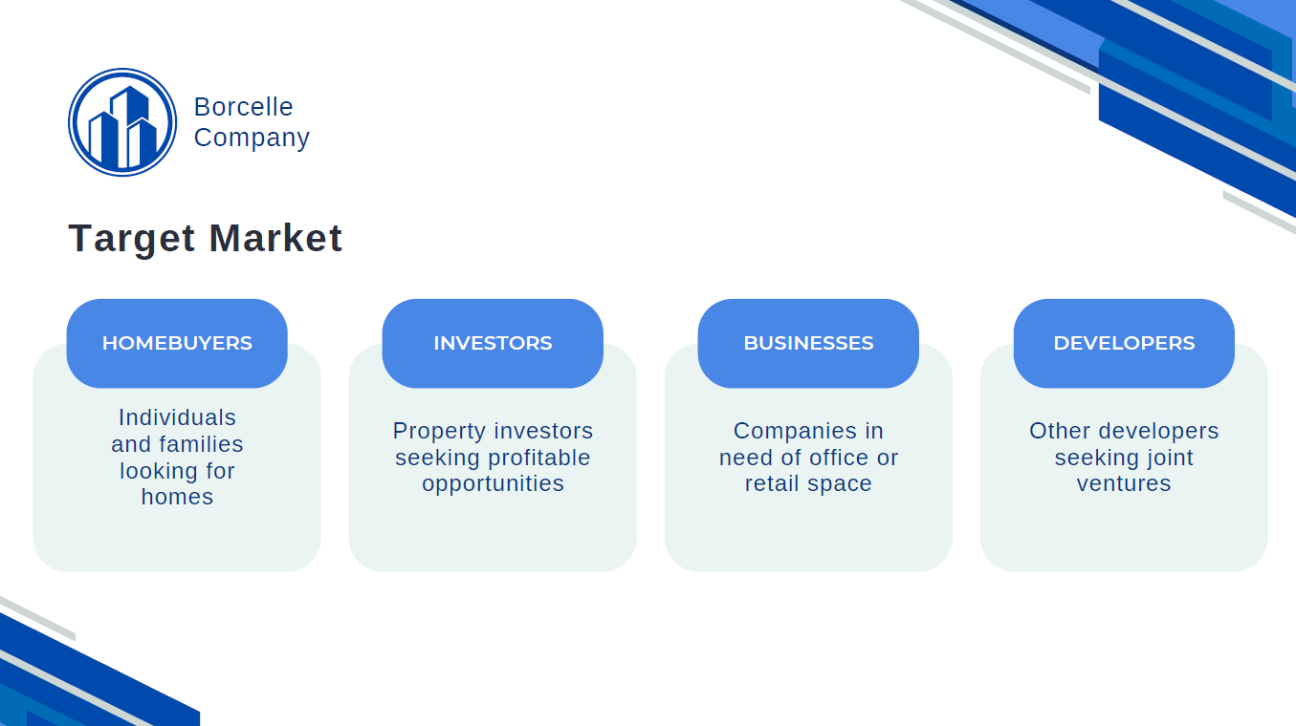
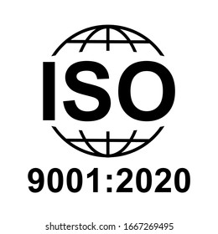

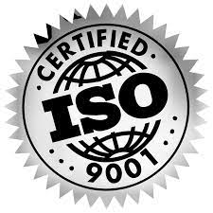





Our Services
STANDARDS SALES
STANDARDS DEVELOPMENT
CERTIFICATION:
MANAGEMENT SYSTEMS
PRODUCT CERTIFICATION
STANDARDS-BASED TRAINING
PRODUCT TESTING
WTO ENQUIRY POINT
SCALES & METROLOGY SERVICES
INFORMATION DISSEMINATION
.
#ImprovingTheWorldWeLiveIn

Slide 6

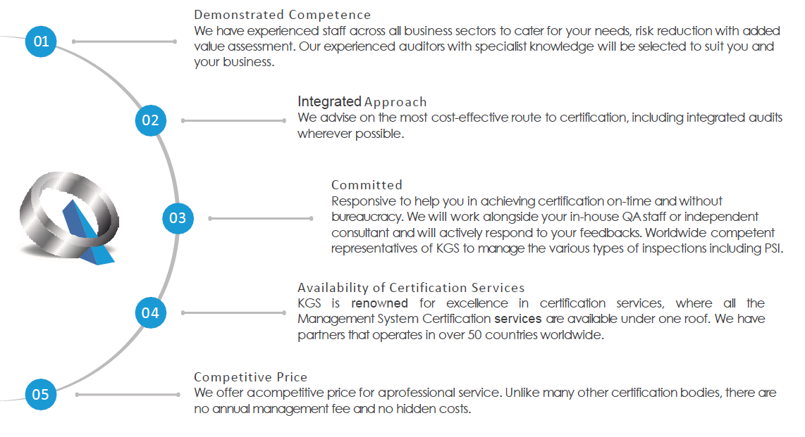
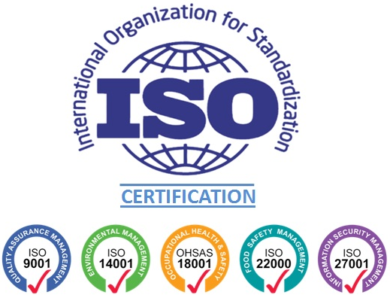

Why ESWASA?
Demonstrate Competence
To meet your goals, lower risk, and give additional value evaluation, we have skilled personnel from different business areas. ESWASA has competent, experienced, and academically skilled experts in various fields at its disposal.
Integrated Approach
We offer guidance on the most economical path to certification, which, when practical, includes integrated audits.
Prompt Support
To assist your institution in obtaining certification quickly and without red tape, we are dedicated to offering prompt support
OHS 45001
Committed
We will actively reply to your input while collaborating with your internal Quality Assurance team or an independent consultant.
Competitive Price
We offer competitive pricing for our professional services. There are no annual management fees and no hidden costs.
#ImprovingTheWorldWeLiveIn

Slide 7
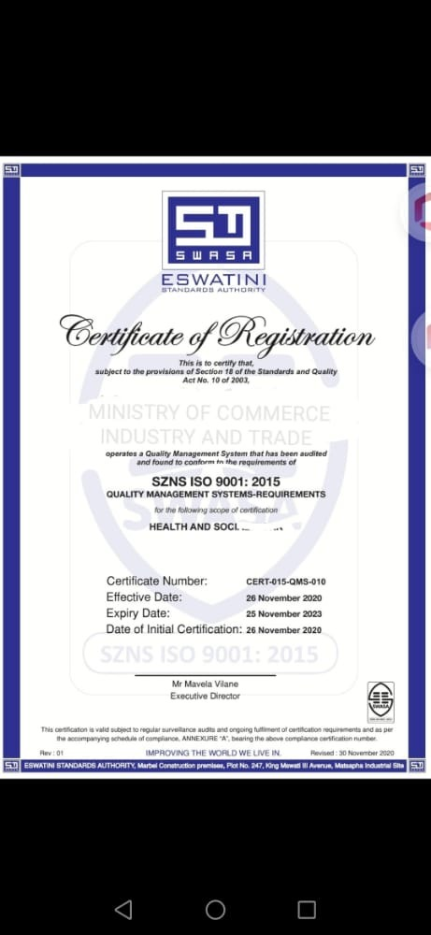
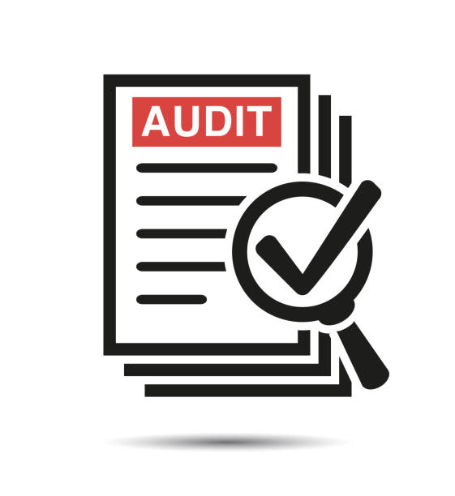
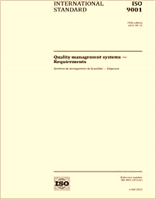


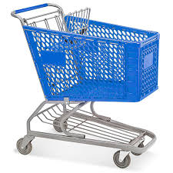
Implementation Of Standards
Certification approval
Buy the Standards:
QUALITY MANAGEMENT SYSTEMS SZNS ISO 9001:2015 – E486,25
OCCUPATIONAL HEALTH& SAFETY MANAGEMENT SYSTEMS SZNS ISO 45001:2018 – E742,91
ENVIRONMENTAL MANAGEMENT SYSTEMS SZNS ISO 14001:2015 – E599,93
5
Certification audit
4
1
3
2
Implementation:
self or consultancy
Attend Standards-based Training
E5 500 per person – Understanding& Implementation
E2 500 per person – Management Awareness
#ImprovingTheWorldWeLiveIn

Slide 8
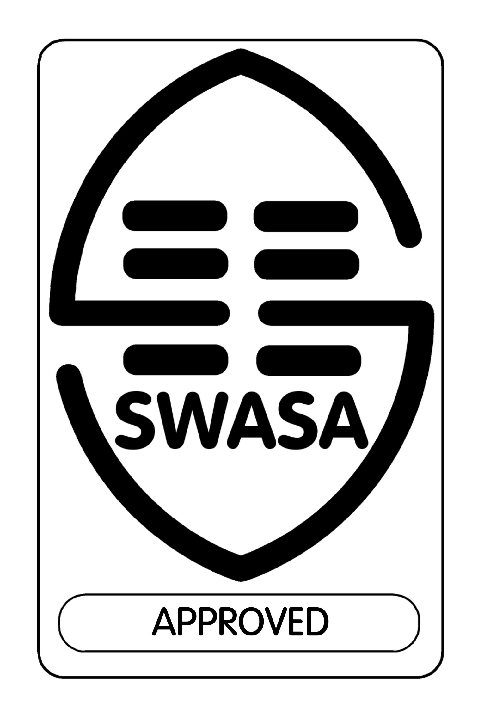
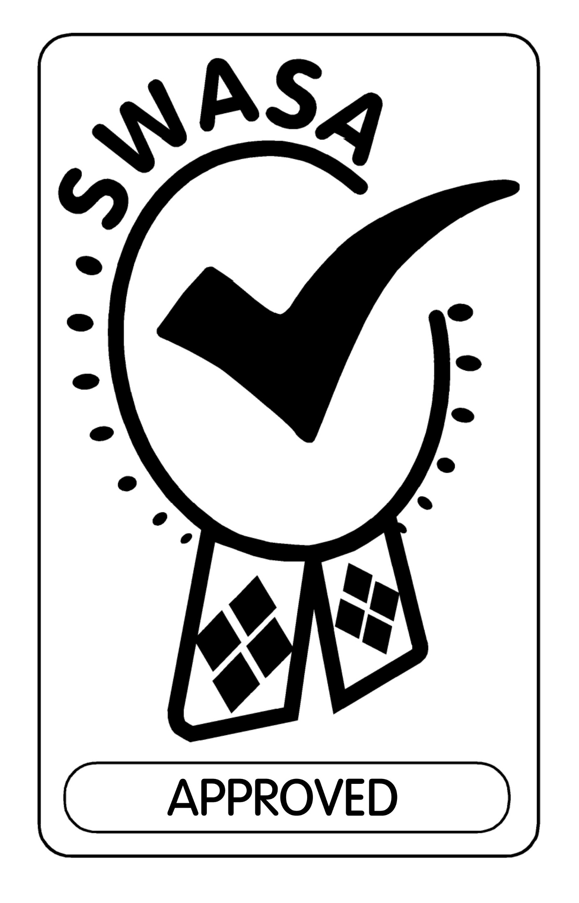

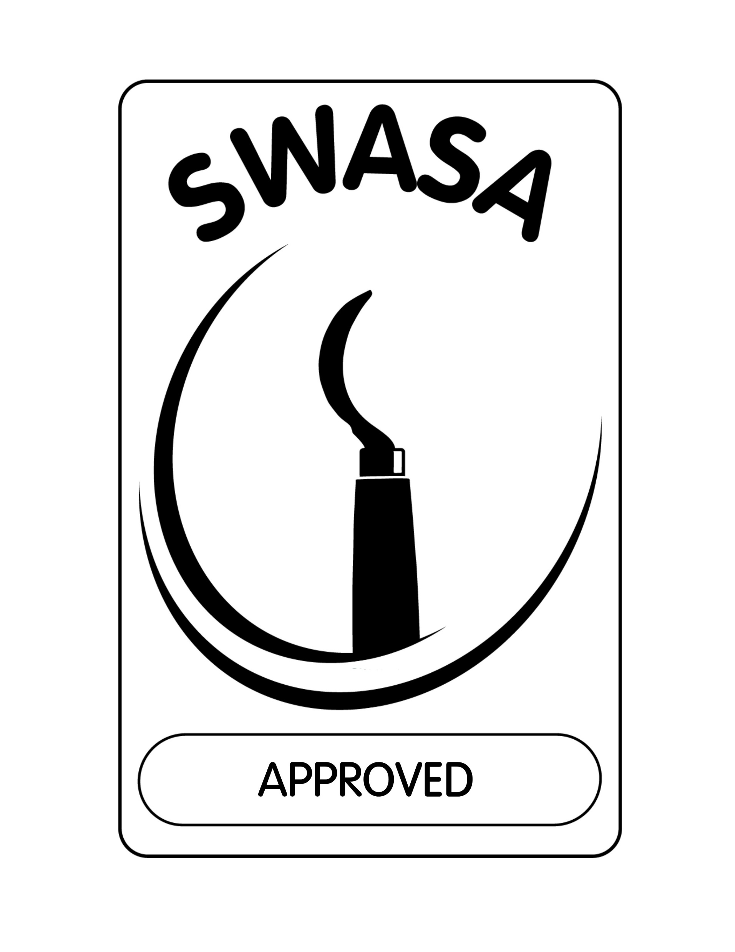
ESWASA MARKS
Management Systems Certification Mark
Product Certification Mark
Compulsory Standards Quality Mark
Ingelo Certification Scheme Mark
#ImprovingTheWorldWeLiveIn

Slide 9

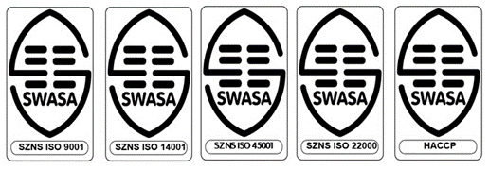
Management Systems& Product Certification
CERTIFICATION BENEFITS:
Increased market share
Increased efficiencies (reduced costs and wastage)
Increased consistency in practices and product/service quality
Increased customer satisfaction
Increased risk management
Increased access to financial support services
Reduced liability risk
Provides for continuous systematic verification of effectiveness
Improved credibility and image
ESWASA implemented the ISO 17021 and 17065 Standards on our management systems and product certification schemes in order to provide trusted certification services and assurance that products and services meet customer expectations.
The Authority is further mandated to administer certification marks for both management systems and product certification schemes.
#ImprovingTheWorldWeLiveIn

Slide 10
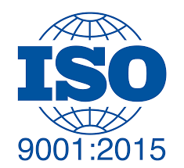
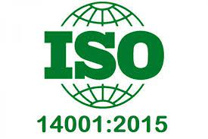
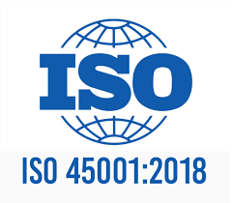
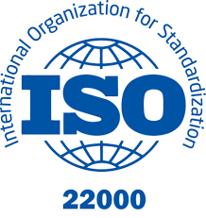
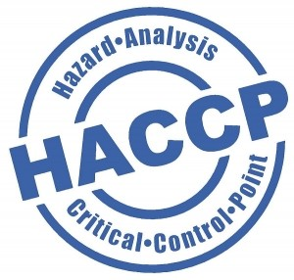
Certifications Offered
SZNS ISO 9001:2015
Quality management systems – Requirements
SZNS ISO 14001:2015
Environmental Management Systems Requirements
SZNS ISO 45001:2018
Occupational Health and Safety Management Systems
SZNS ISO 22000: 2018
Food safety management systems Requirements for any organization in the food chain
SZNS SANS 10330:2020
Requirements for a Hazard Analysis and Critical Control Point (HACCP) system
#ImprovingTheWorldWeLiveIn

Slide 11
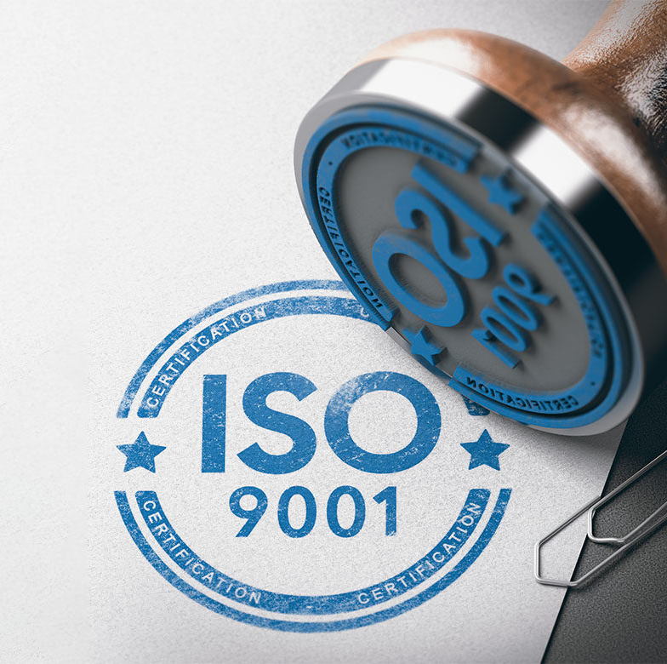

SZNS ISO 9001:2015
SZNS ISO 9001 Certification is one of the most recognized and leading ISO standards on Quality Management Systems (QMS).
If your business is SZNS ISO 9001 Certified, it shows that your organization follows internationally recognized standards for ensuring quality throughout every aspect of your business. This includes everything from manufacturing to customer service. The certification is meant to be used by any organization, regardless of its magnitude, category, or nature.
Improved Operational Efficiency
Enhanced Customer Satisfaction and Loyalty
Increased Employee Engagement
Better Decision-Making Through Data
Reduced Waste and Improved Resource Management
Compliance with Statutory and Regulatory Requirements
Consistent Product and Service Quality
Increased Competitiveness in Eswatini and International Markets
Easier Integration with Other ISO Standards
Structured Approach to Risk Management
Enhanced Supplier Relationships
Clear Internal Communication
Culture of Continuous Improvement
#ImprovingTheWorldWeLiveIn

Slide 12
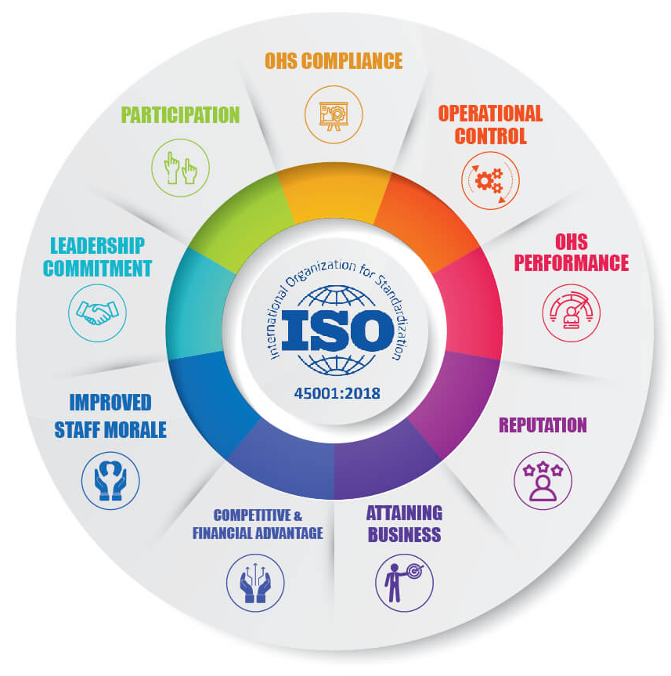
SZNS ISO 45001:2018
SZNS ISO 45001 is an International Standard that outlines the standards for an Occupational Health and Safety (OH&S) Management System, as well as for instructions on how to apply it, in order for an organization’s OH&S performance to be proactive in preventing injury and sickness. The certification is meant to be used by any organization, regardless of its magnitude, category, or nature.
SZNS ISO 45001 is a standard for companies who are serious about enhancing employee safety, eliminating workplace risks, and establishing better, safer working conditions. Thousands of people perish each day as a result of avoidable workplace hazards.
An OH&S management system based on SZNS ISO 45001 will enable an organization to improve its OH&S performance by:
Set up checks and balances to ensure legal compliance
Raise Public Awareness of Health and Safety
Improve your public image
Absenteeism should be reduced
Insurance Premiums Should Be Reduced
Management of H&S Compliance Issues should be improved
Improved Health and Safety Risk Management
Increases the accuracy of danger detection and risk assessment
Reduces downtime, overall expenses of workplace events, and the number of claims for insurance premiums
Enhances leadership involvement as well as worker participation.
#ImprovingTheWorldWeLiveIn

Slide 13

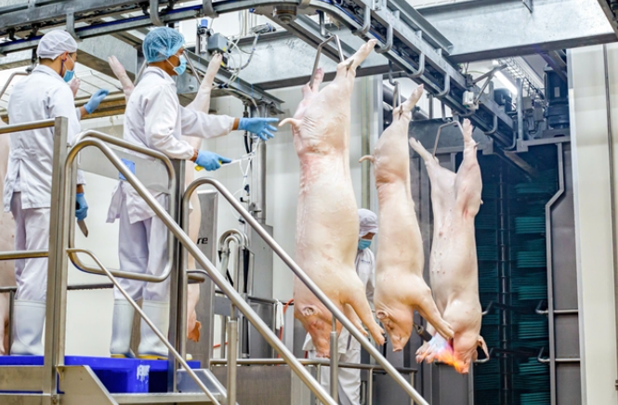
SZNS ISO 22000:2018
The implementation of a HACCP system to identify hazards and establish control measures for food safety, with SZNS ISO 22000 providing the overall framework for your entire food safety management system. SZNS ISO 22000 is a globally recognised standard for Food Safety Management Systems (FSMS) that can be applied to any industry in the food chain, as it provides a systematic framework for identifying, preventing, and controlling food safety hazards. It integrates HACCP principles into a broader, management-focused system, covering the entire food chain from the farm to the consumer.
Benefits:
Ensures Food Safety: It helps identify and control hazards, leading to safer products for consumers.
Enhances Traceability: The system requires documentation and records, which help in accounting for all stages of production and improving traceability.
Boosts Marketability: Certification can increase market access, particularly for export, as it demonstrates adherence to international food safety standards.
Improves Overall Performance: A systematic approach to food safety leads to better performance and a more robust management system.
Ongoing Compliance: Periodic audits to ensure continued adherence to the SZNS ISO 22000 standard.
#ImprovingTheWorldWeLiveIn

Slide 14


SZNS ISO 14001:2015
SZNS ISO 14001 certification offers numerous advantages, including improved environmental performance (reduced waste and pollution), significant cost savings through increased efficiency, easier regulatory compliance, enhanced reputation, increased stakeholder trust, and competitive advantages. It enables firms to enter new markets by showing their commitment to sustainability through a systematic Environmental Management System (EMS). It promotes operational excellence through continuous improvement and increases employee engagement by linking values to positive outcomes.
Key Benefits of SZNS ISO 14001 Certification:
Enhanced Environmental Performance: Reduces waste, resource consumption (energy, water), and pollutant emissions, minimizing your footprint.
Cost Savings: Efficient resource use, waste minimization, and streamlined processes lower operating costs.
Regulatory Compliance: Helps meet legal requirements, avoiding fines and penalties by integrating compliance into your system.
Improved Reputation & Trust: Shows commitment to sustainability, building credibility with customers, investors, and the community.
Market Access & Competitive Edge: Can be a prerequisite for contracts and differentiates you from competitors.
Better Risk Management: Identifies, assesses, and controls environmental risks, preventing disruptions.
Operational Efficiency: Promotes leaner processes, waste reduction, and increased productivity.
Employee Engagement: Fosters a sense of ownership and motivation by involving staff in environmental goals.
Continuous Improvement: Embeds a culture of ongoing evaluation and improvement in environmental practices.
#ImprovingTheWorldWeLiveIn

Slide 15
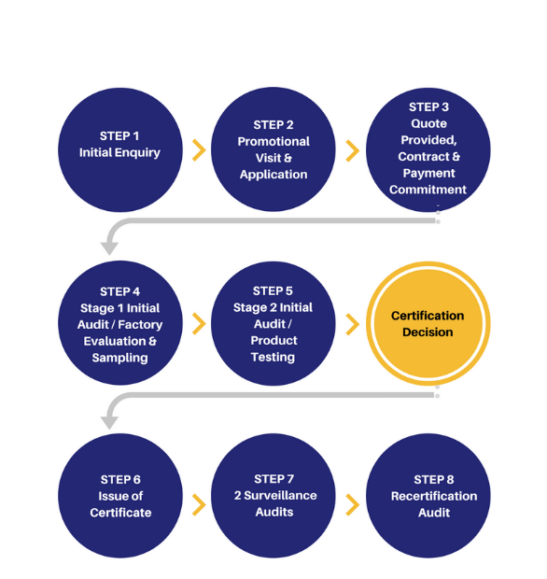
Obtain SZNS ISO Certification
1. Preliminary Assessment: Conduct a self-assessment to identify areas needing improvement within your operations.
2. Documentation: Develop and maintain clear, comprehensive records of all practices, procedures, and processes related to your company.
3. Training: Ensure that all employees are adequately trained in accordance with the requirements of the SZNS ISO standard.
4. Third-party Audit: Engage a certification body for a thorough inspection to verify compliance with the standard.
5. Corrective Actions: Rectify any non-conformities identified during the audit before certification can be granted.
#ImprovingTheWorldWeLiveIn

Slide 16
Certification Process
ACTIVITY | TIMELINE
Quotation acceptance and Application | Stage 1 Audit scheduled during application
Contracting | Following application
Stage 1 Audit (includes testing for product certification) | As soon as readiness is communicated by client
Clearing of stage 1 Audit findings | To be completed within 6 months from audit date, otherwise re-do stage 1 (can be completed within a shorter timeframe depending on how quick you are to clear the findings)
Stage 2 Audit (includes testing for product certification) | To be conducted upon communication of clearance of stage 1 findings
Clearing of stage 2 Audit findings | To be completed within 6 months from audit date (can also be completed within a shorter timeframe depending on how quick you are to clear the findings)
Certification Approval Committee (CAC) sitting | Client file reviewed by committee to decide whether to certify or not ( within a week upon completion of clearance of stage 2 findings)
Certification decision communicated | Following CAC meeting
Certificates printing and presentation
Activities after certification is granted ( for maintenance of certification)
Surveillance 1 (Includes product testing for product certification) | Within the first 12 months after certification
Surveillance 2 (Includes product testing for product certification) | Within 12 months after first surveillance
Certificate expiry | After 3 years
Recertification activities resumption | 6 months before expiry of current certificate.
#ImprovingTheWorldWeLiveIn

Slide 17
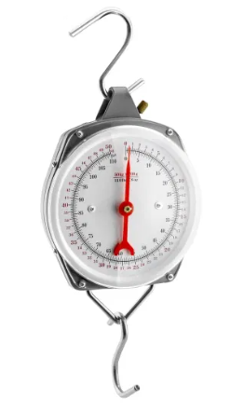
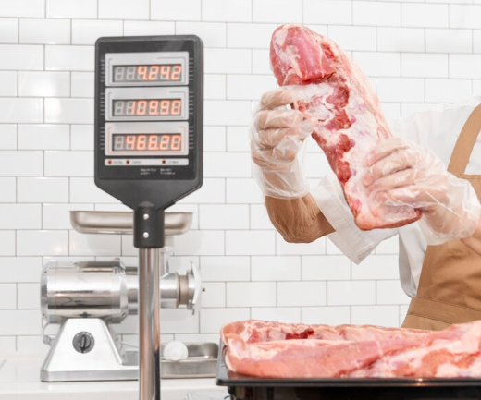

Metrology Services (ISO/IEC 17025)
Testing Facilitation Services
(ISO/IEC 17025)
We understand the importance of accurate and reliable measurements for your business. That is why we strive to provide the best calibration services available.
Our team of highly skilled technicians are dedicated to providing you with exceptional scale sales, service, repairs, installations, and calibration of all weighing equipment, weighbridges, and metrology equipment.
We utilise only the finest industry-standard equipment and procedures to ensure that all your measuring and testing instruments consistently function at their best, remaining accurate and reliable.
ESWASA is committed to ensuring the quality of products.
We are readily available to assist in the Testing of commodities through the selection of accredited laboratories that will best cater for the required scopes.
Measure the effects of ageing on products
Monitor potential threats from competing products
Safety
Overcome Trade Barriers
Provides evidence in legal proceedings
Applicability
#ImprovingTheWorldWeLiveIn

Slide 18
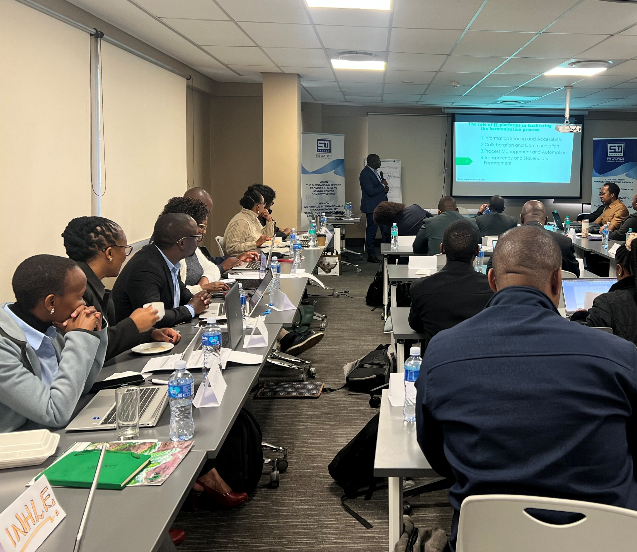
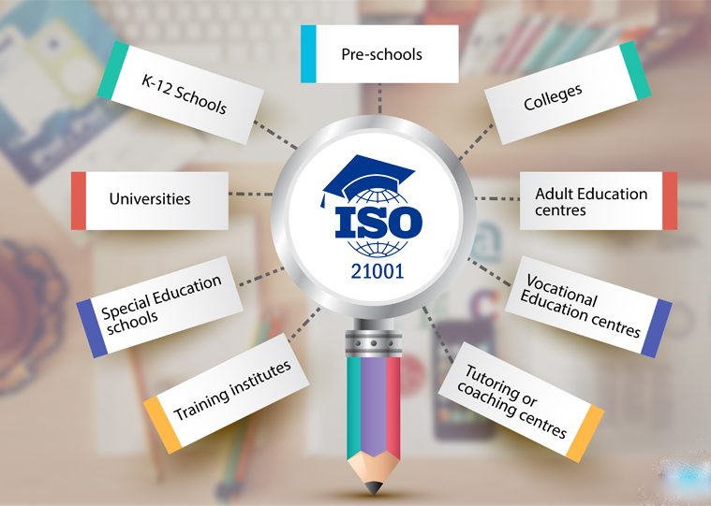


ESWASA offers specialized Standards-based trainings to industry, individual’s, government agencies and other Institutions in Management Systems.
These training courses put individuals and organizations on the fast track to success as it leverages the competitiveness of products or services in both local and international markets.
Quality Management Systems
Environmental Management Systems
Food Safety Management Systems
Occupational Health & Safety Management Systems
Global GAP
Integrated Management Systems
Auditing
Risk Management
Business Continuity
Wellness Management
Other tailor-made Standards-based trainings
Standards-based Trainings
#ImprovingTheWorldWeLiveIn

Slide 19
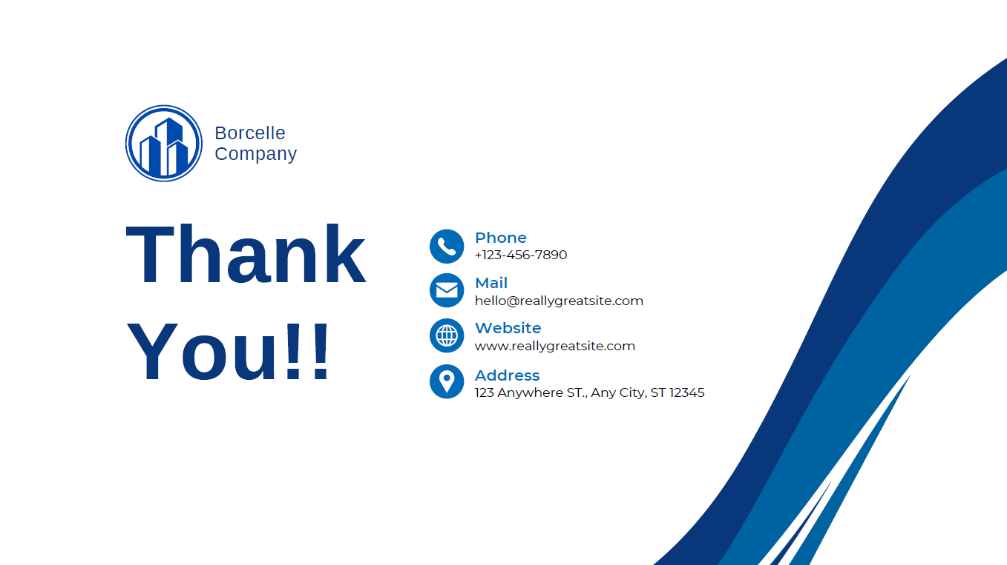





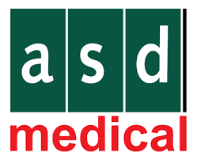


Our Clients
M P Food Processors (pty) Ltd
#ImprovingTheWorldWeLiveIn

Slide 20
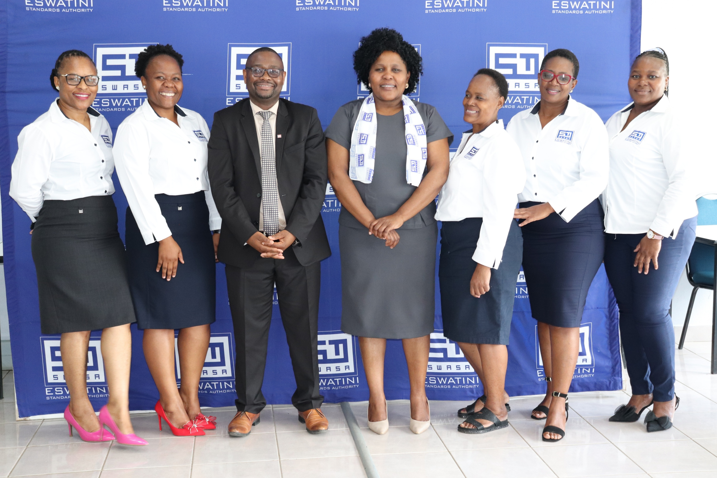
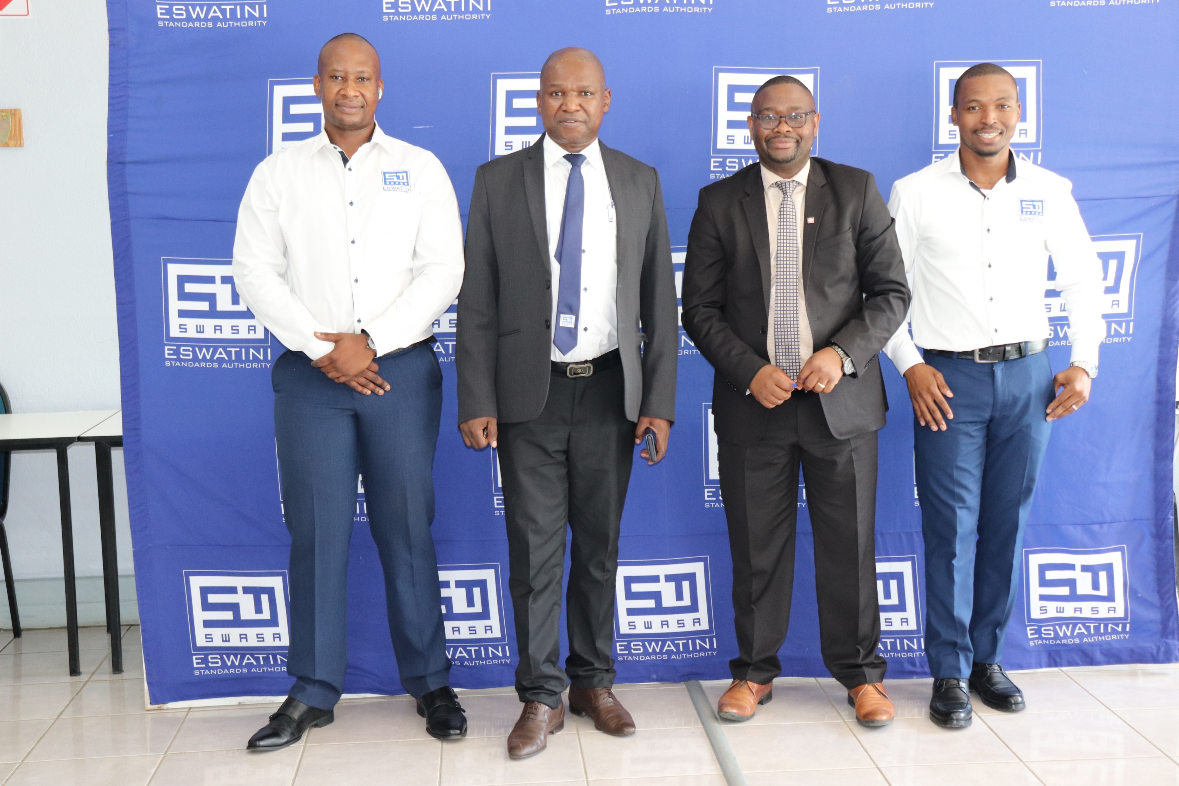
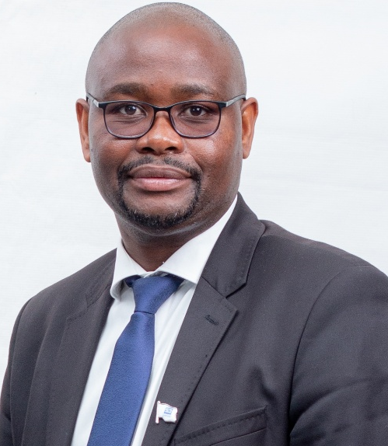


Our Team
Mr. Ncamiso K. Mhlanga
Executive Director
Mr. Phillip G. Mndawe
Technical Manager
Ms. Dumsile Masina
Chief Financial Officer
#ImprovingTheWorldWeLiveIn

Slide 21
Contact Us
(+268) 2518 4633
(+268) 2518 4610
www.swasa.co.sz
info@swasa.co.sz
Plot 247, Marbel Construction Premises, King Mswati III Avenue West
Matsapha Industrial Site
P.O. Box 1399,
Matsapha, Eswatini
#ImprovingTheWorldWeLiveIn

